Slide 1

USER THROUGHPUT
TIME SERIES FORECASTING
Abhishek Gupta agupta001@regis.edu
Abhishek Gupta agupta001@regis.edu

Slide 2

PROBLEM STATEMENT
Problem Statement
Degradation in important cellular Network KPIs like Downlink throughput can impact the satisfaction of end user negatively.
Devices have become more data centric rather than traditional calling or messaging services. Slow downloads speed can make a customer unhappy and hence its very important to provide customers with a good throughput speed. The operators try to maintain a minimum average throughput to make sure customer enjoy a good experience. Its important to know in advance when the KPI might go below the targeted threshold so that operators can proactively work towards improving the Throughput by network optimization or adding more capacity and resources.
Research Question
Can time series forecasting help in predicting the Downlink Throughput KPI that can help cellular operators maintain the satisfaction level of customers by providing better experience?
Methodology
To answer the research question presented above, I used Time Series Forecasting to predict the User Downlink Throughput. For predicting the Throughput, I used ARIMA, XGBoost and LSTM models. The performance observed with all the three models will be discussed later in the presentation.

Slide 3

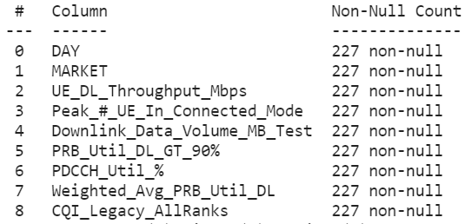
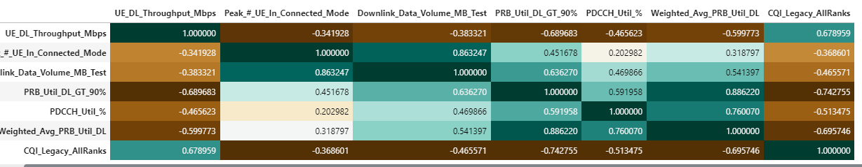
Exploratory Data Analysis
For my project, I collected the Data for 1 market of a telecom operator. The data was collected for the last 227 days.
The data set has 9 columns which include Average User Downlink throughput along with other relevant KPIs. The Dataset has a total of 9 columns which are shown here on the right.
There were no null or missing values in the collected data.
The intent for this project will be to predict UE_DL_Throughput.
Correlation plot shows that UE_DL_Throughput has high inverse correlation with PRB_Util_DL_GT_90% and Weighted_Avg_PRB_Util_DL and high direct correlation with CQI_Legacy_AllRanks.

Slide 4

METHODOLOGY
Data Collection
Exploratory Data Analysis
Train/Validation/Test Split
Modeling/ Forecasting and Evaluation
Raw Data was collected for one Market of a Telecom operator. The Market represents an area consisting of thousands of cellular nodes serving millions of wireless customers
Exploratory Data analysis was performed to understand the data.
Data was split into Train and Test data. 177 samples were used for training and 50 samples were used for evaluating the model prediction.
Time Series forecasting methods like ARIMA, XGBoost, LSTM will be used for forecasting user Downlink Throughput. The compiled models were used for prediction and the results were evaluated.

Slide 5

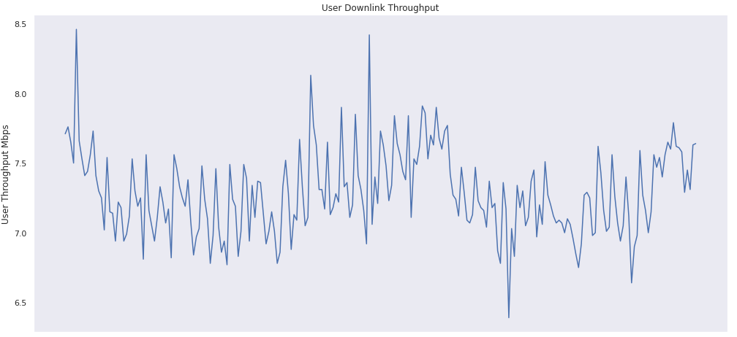
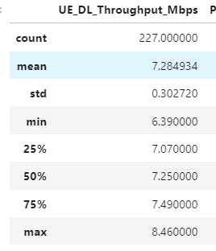
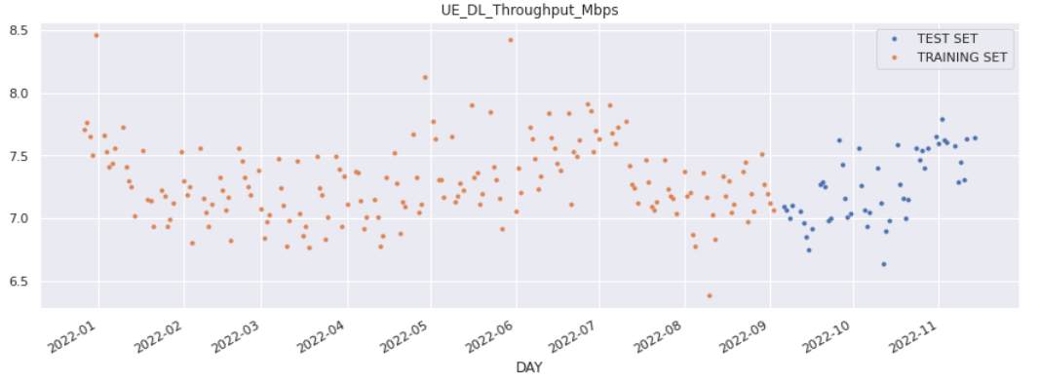
DATA UNDERSTANDING
The plot shows the UE_DL_Throughput for the last 227 days. The average throughput for the entire period is 7.28 Mbps with minimum of 6.39 Mbps and Max of 8.46 Mbps.
The data was split into Train and Test set. Training set has 177 samples and Test set has 50 samples .
Since its time series forecasting problem, its important to make sure that the test data follows training data and should not be random from anywhere in the data set.

Slide 6

MODELING
For the Time series forecasting, I will be using three models – ARIMA , XGBoost and LSTM
ARIMA stands for Auto-Regressive Integrated Moving Averages. ARIMA is a forecasting algorithm based on the idea that the information in the past values of the time series can alone be used to predict the future values.
XGBoost is short for Extreme Gradient Boosting and is an efficient implementation of the stochastic gradient boosting machine learning algorithm. XGBoost is developed on the framework of gradient boosting.
Long Short-Term Memory networks – usually just called “LSTMs” – are a special kind of RNN, capable of learning long-term dependencies.
The models will be compiled on the training data and prediction will be made. The results will be evaluated, and I can compare which model performed best.

Slide 7

ARIMA MODEL1
ARIMA is a forecasting algorithm based on the idea that the information in the past values of the time series can alone be used to predict the future values.
ARIMA Models are specified by three order parameters: (p, d, q).
p is the order of the AR term
q is the order of the MA term
d is the number of differencing required to make the time series stationary
p is the order of the Auto Regressive (AR) term. It refers to the number of lags of Y to be used as predictors.
The value of d, is the minimum number of differencing needed to make the series stationary. If the time series is already stationary, then d = 0.
q is the order of the Moving Average (MA) term. It refers to the number of lagged forecast errors that should go into the ARIMA Model.
Using Rolling Statistics and Augmented Dickey-Fuller Test, it was established that the Time Series is stationary.

Slide 8
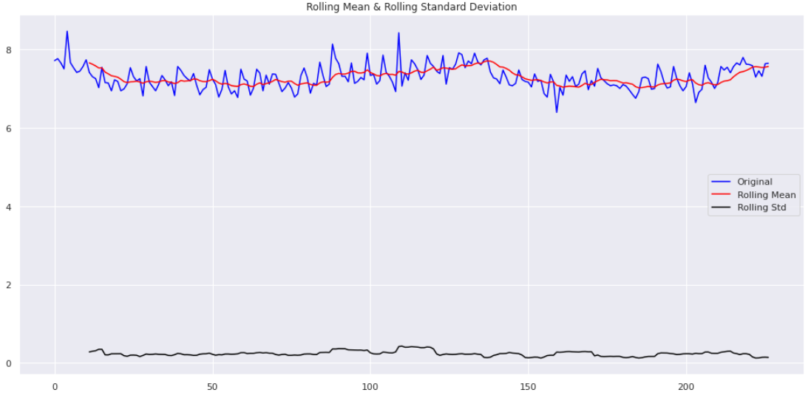
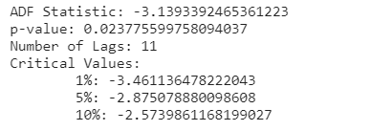
ARIMA- TIME SERIES STATIONARY CHECK
Rolling Statistics: The time series is stationary if the rolling mean and rolling standard deviation remain constant with time (with the naked eye look to see if the lines are straight and parallel to the x-axis).
Augmented Dickey-Fuller Test: dickey-fuller test can be used to check if the data is stationary or not. The time series is considered stationary if the p-value is low (according to the null hypothesis) and the critical values at 1%, 5%, 10% confidence intervals are as close as possible to the ADF Statistic. p-value is 0.02377 which is less than 0.05 so we can say the time series is stationary.

Slide 9
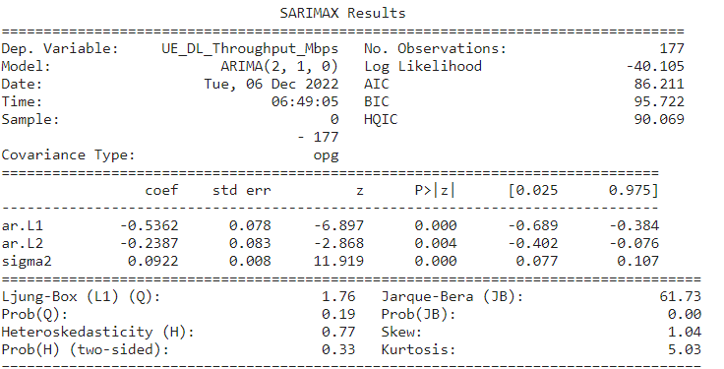
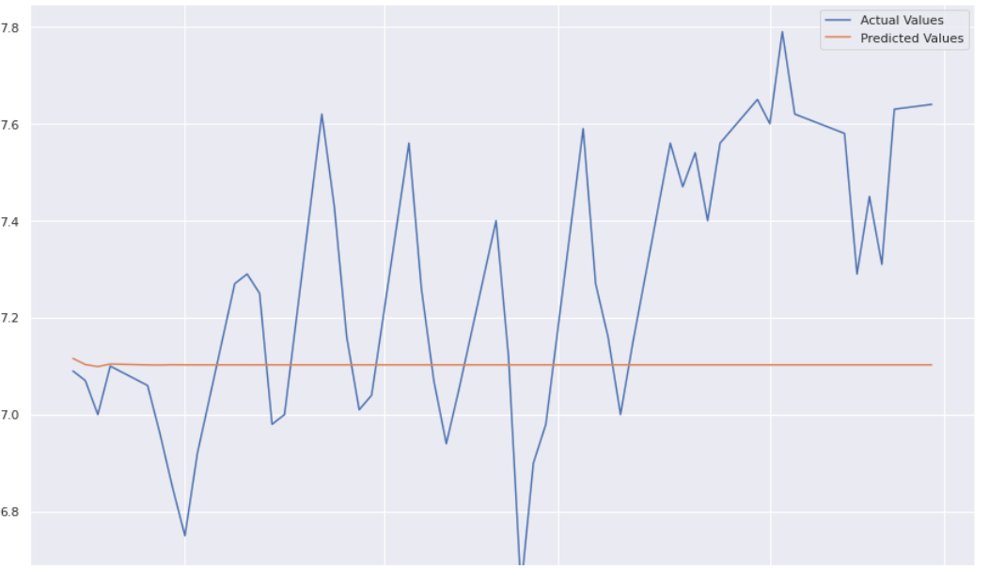
ARIMA(2,1,0) MODEL 1 EVALUATION
Since we confirmed that the time series is stationary, we will use
the value of d as 0
Using the PACF plot we saw significant lags at 1 , 2, 4, 5.
I will use ARIMA(2,1,0) and ARIMA(5,1,0) as our models for Time
Series Prediction.
The Actual vs Predicted value shows a RMSE of 0.317262
RMSE Observed is 0.31726272744507383

Slide 10
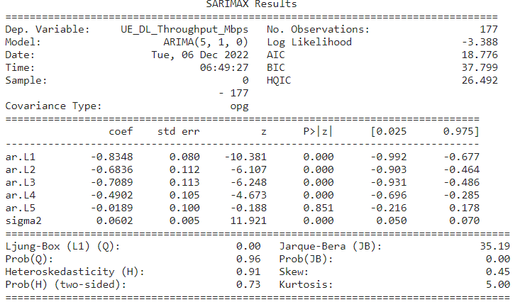
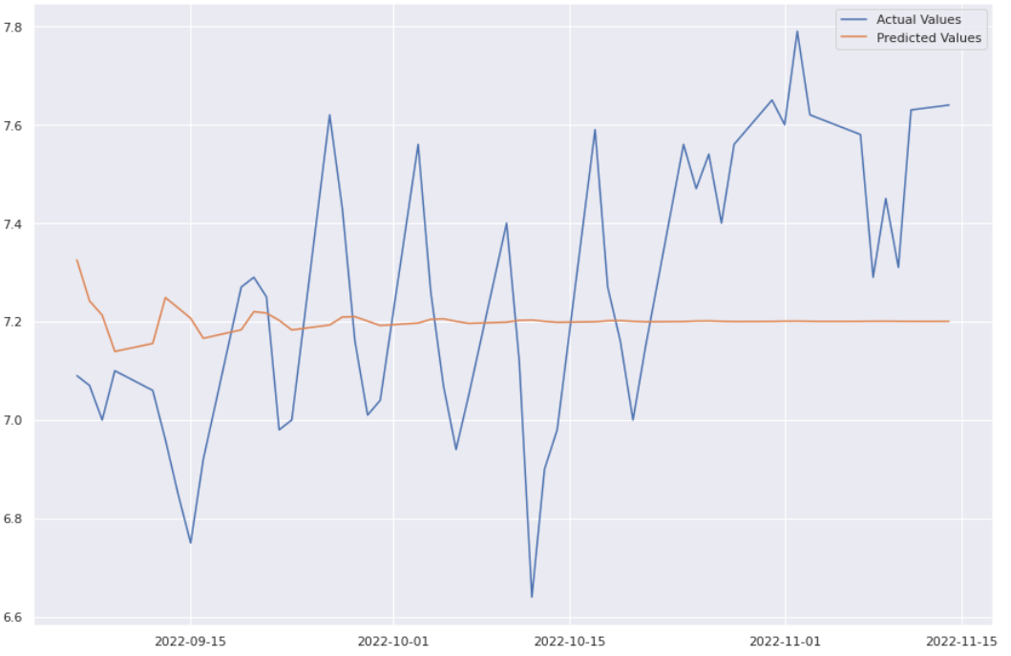
ARIMA(5,1,0) MODEL 1 EVALUATION
The Actual vs Predicted value shows a RMSE of 0.317262
RMSE Observed is 0.28685760555816986

Slide 11

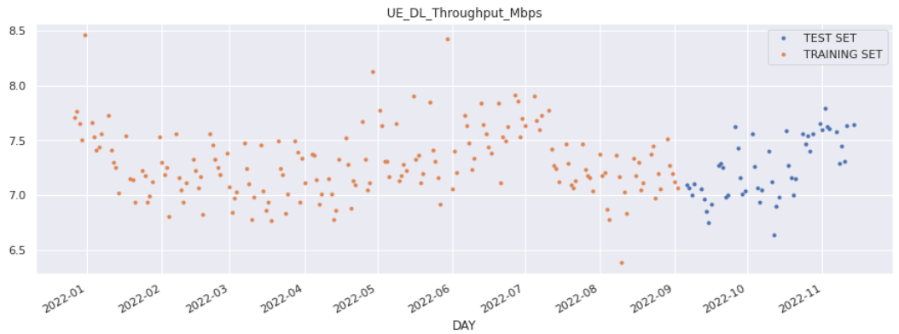
XGBoost MODEL 2
XGBoost is short for Extreme Gradient Boosting and is an efficient implementation of the stochastic gradient boosting machine learning algorithm.
The data was split into train and test data. XGBoost model was trained on training data and predicted the throughput values for the next 50 days which was compared with the test data and the results were evaluated.
To apply XGBoost I restructured the data so that it pretends to be a supervised learning problem with a target variable Y.

Slide 12
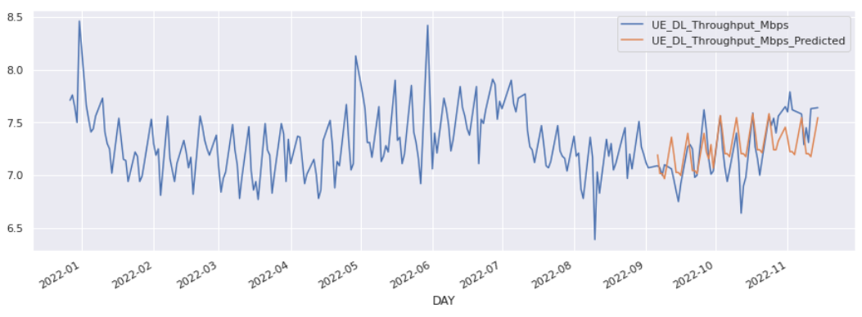
XGBoost MODEL 2 - EVALUATION
Model was instantiated and our training data was fit into the model. Further the model was used for prediction on the test data.
The model predicted the values in the range of Test data actual throughput values.
XGBoost Predicted throughput values vs actual throughput values showed RMSE of 0.22398 which was better than the ARIMA models.
RMSE Observed is 0.22398439419934787

Slide 13
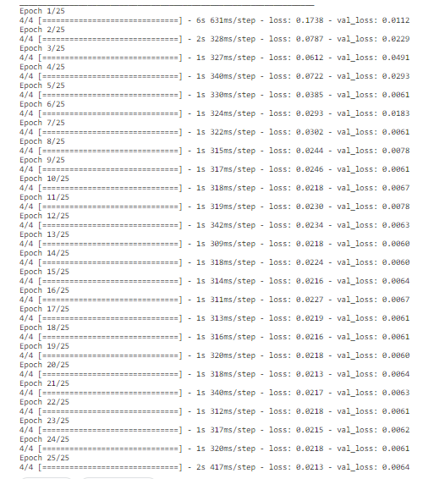
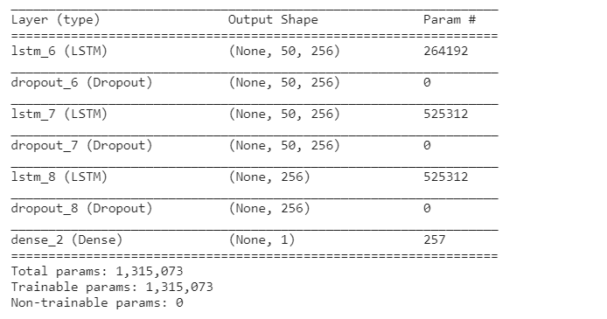
LSTM MODEL 3
The Data was separated into training and test data. The test data was used for evaluation.
Data was scaled before model was used to learn from the data. Scaling helps in reducing the training time in case of neural networks. Data was scaled in the range of 0 and 1.
Dropout of 10% was used to increase efficiency and reduce overfitting.

Slide 14
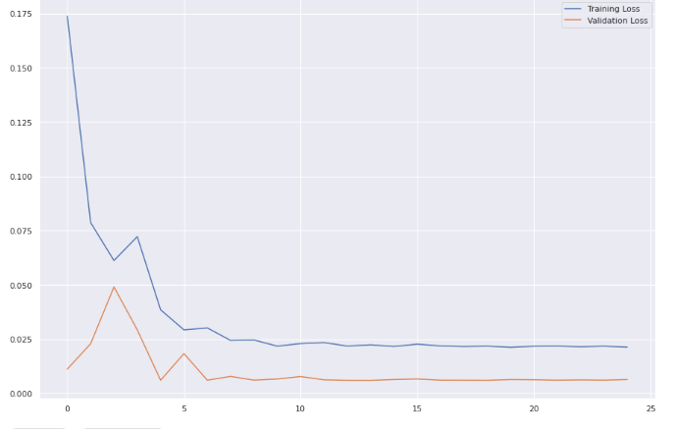
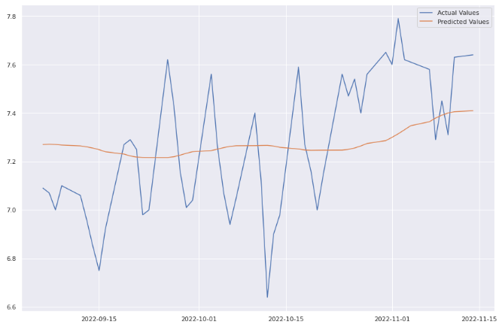
LSTM MODEL 3 - EVALUATION
The chart on the right shows Training loss vs Validation loss.
The training loss indicates how well the model is fitting the training data, while the validation loss indicates how well the model fits new data.
We can see the loss reduces for both Training and Validation plots and reaches a point of stability.
The compiled model was used for prediction of UE_DL_Throughput.
The model predicted the throughput for 50 days and the predicted values were compared with actual test values.
The LSTM model RMSE was better than ARIMA models and slightly higher than XGBoost.
RMSE Observed is 0.26272519376520337

Slide 15

CONCLUSION
For this project, I used Time Series Forecasting to predict UE_DL_Throughput in Mbps
I used ARIMA , XGBoost and LSTM models to predict the Downlink UE Throughput and compared the performance.
For ARIMA, I used ARIMA(2,1,0) and ARIMA(5,1,0). RMSE observed was 0.317 and 0.287, respectively.
RMSE obtained from XGBoost was 0.224 which was better than ARIMA models.
With LSTM, the RMSE seen was 0.263, worse than XGBoost but better than ARIMA models
In terms of model performance, XGBoost showed the best result followed by LSTM.
For Future work, impact of other KPIs will be considered to predict throughput. Performance can be compared with univariate analysis.

Slide 16
THANK YOU

